Slide 1
ANTHROPIC
Introduction to the
Claude Ecosystem
Models · Products · Pricing · Safety · What Makes Claude Different
Comprehensive Overview ·

Slide 2
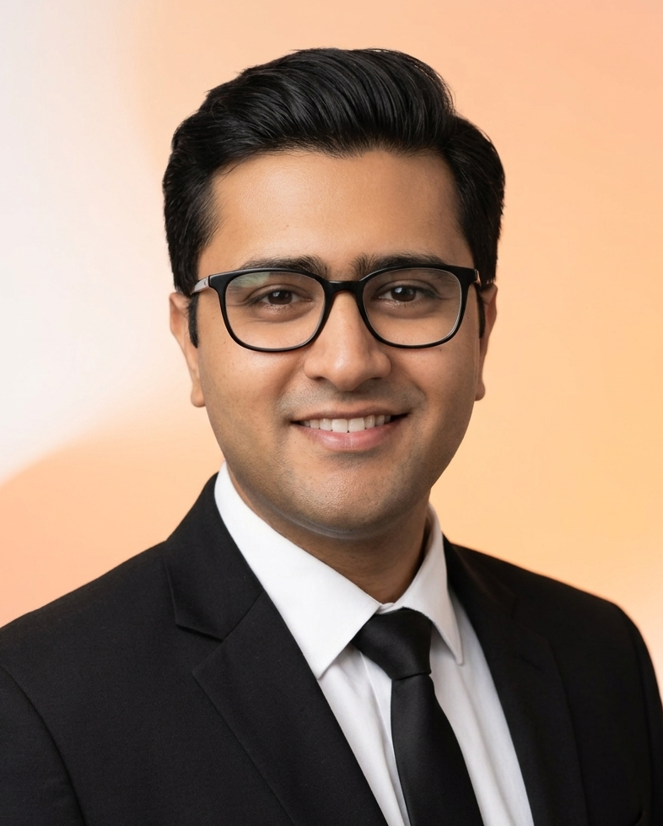
MEET YOUR TRAINER
Trainer Introduction
About
Harsh Dalal is a certified AI educator and corporate trainer specialising in Microsoft, Google, and emerging AI technologies. With hands-on experience designing and delivering enterprise training programs, Harsh has helped hundreds of professionals upskill across AI tools, productivity platforms, and digital transformation.
Harsh Dalal
Areas of Expertise
Claude Architect
AI & Copilot Training
Google Workspace
AI Trainer & Consultant
Microsoft 365 Copilot, Copilot Studio, Claude AI
Certified Google Educator — Workspace & AI features
Enterprise Automation
Digital Transformation
Agentic workflows, RPA, and process optimisation
Upskilling programs for HR, Finance, IT, and Sales
LinkedIn
Email
Website
Claude Ecosystem· AI Training Series ·

Slide 3
AGENDA
What We Will Cover
01
04
What is Claude?
Pricing Plans
Origin, mission and Anthropic's vision
Free · Pro · Team · Enterprise
02
05
Claude Model Family
Constitutional AI
Haiku · Sonnet · Opus — when to use each
How safety is baked into Claude's DNA
03
06
Claude Products
What Makes Claude Unique
Claude.ai, Code, Cowork and more
Key differentiators vs other LLMs

Slide 4
ABOUT CLAUDE
What is Claude?
Claude is an AI assistant built by Anthropic — a safety-focused AI company founded in 2021. Claude is designed to be helpful, harmless, and honest, making it one of the most trusted large language models available today. Anthropic's core mission is the responsible development and maintenance of advanced AI for the long-term benefit of humanity.
2021
#1
Year Anthropic founded
Safety-first AI lab
3
6+
Model tiers available
Products in ecosystem
"Being helpful, harmless, and honest isn't a constraint — it's the goal." — Anthropic

Slide 5
MODEL FAMILY
Claude Model Tiers
FAST & LIGHT
BALANCED
MOST CAPABLE
Claude Haiku
Claude Sonnet
Claude Opus
claude-haiku-4-5
claude-sonnet-4-6
claude-opus-4-6
The fastest, most compact model. Ideal for real-time applications, high-volume pipelines, customer support, and any use case where speed and cost matter most.
The sweet spot of intelligence and speed. Best for everyday use, coding, analysis, writing, and complex reasoning at production scale.
Anthropic's most powerful model. Tackles the most nuanced, multi-step tasks — advanced research, complex reasoning, and frontier-level coding challenges.
Real-time chat
Code generation
Deep research
Classification
Data analysis
Complex reasoning
Summarisation
Long-form writing
Strategic planning
Cost-efficient pipelines
Agentic workflows
Advanced coding
All models: 200K token context · Vision · Tool use · Streaming · Batch API

Slide 6
PRODUCTS
The Claude Product Ecosystem
Claude.ai
Claude API
Claude Code
Consumer web and mobile chat interface. Supports Projects, Artifacts, image generation, web search, and memory.
Build custom AI apps via REST. Python and TypeScript SDKs. Supports tool use, streaming, vision, and batch processing.
Agentic CLI and desktop tool for developers. Reads and edits codebases, runs tests, writes commits, and opens PRs.
Claude Cowork
Claude in Chrome
Claude in Excel & PowerPoint
Desktop automation for non-developers. Manages files and tasks; orchestrates Excel, Chrome, and PowerPoint agents.
Beta browser agent. Navigates the web, fills forms, and completes multi-step online tasks on your behalf.
Spreadsheet and slides agents. Generate charts, clean data, build presentations using natural language.

Slide 7
CLAUDE CODE
Claude Code
Agentic coding assistant that lives in your terminal
Reads entire codebases
Writes and edits files
Understands your full repo structure, imports, and dependencies — no need to paste snippets.
Applies precise multi-file changes in one coherent diff, with full context awareness.
Runs tests and linting
Git-aware
Executes your test suite, reads failure messages, and automatically fixes the underlying issues.
Creates branches, writes meaningful commit messages, and opens pull requests — all from chat.
MCP server support
Extended thinking mode
Connects to Jira, Linear, GitHub, Figma, Notion, and more via the open MCP protocol.
Uses chain-of-thought reasoning on hard architecture decisions before taking any action.
npm install -g @anthropic-ai/claude-code

Slide 8
PRICING
Plans for Every Need
MOST POPULAR
Free
Team
Enterprise
$0
Pro
$25
Custom
$20
forever
per user / month
contact sales
per month
Access to Claude Sonnet
Everything in Pro
Unlimited usage (SLA)
5x more usage than Free
Limited daily usage
Shared team Projects
SSO and SCIM
All model tiers
Web and mobile access
Admin dashboard
Custom system prompts
Priority access
Basic Projects
Longer context windows
Dedicated support
Extended Projects and context
Collaboration features
Advanced security
Image generation

Slide 9
SAFETY
Constitutional AI
Safety baked in from day one, not bolted on
Core Principles
1
Supervised Learning
Claude is initially trained on human feedback to be genuinely helpful.
Be genuinely helpful
Never deceive or manipulate
2
Self-critique via Constitution
Avoid harmful content
Claude reviews its own outputs against written principles: honesty, harmlessness, helpfulness.
Respect human autonomy
Revision without human labels
Acknowledge uncertainty honestly
3
Claude revises harmful responses using its own critique, reducing reliance on human labellers.
Support human oversight
Protect user privacy
4
RLAIF — RL from AI Feedback
Be transparent about being AI
Reinforcement learning uses Claude's own ranked preferences rather than purely human ones.

Slide 10
DIFFERENTIATORS
What Makes Claude Unique
200K Context Window
Genuine Honesty
Constitutional AI Safety
Process entire codebases, long research papers, or lengthy documents in a single prompt — far beyond most rivals.
Claude admits uncertainty rather than hallucinating. It prefers saying 'I don't know' over confidently fabricating an answer.
Safety is trained via self-critique, not just RLHF — producing a model that reasons about ethics rather than just following rules.
Nuanced Reasoning
Tone and Writing Quality
MCP Ecosystem
Extended thinking mode lets Claude reason deeply before responding, delivering chain-of-thought quality without extra prompting.
Widely recognised for clear, natural prose. Preferred by writers, researchers, and communicators over competing models.
Native Model Context Protocol support connects Claude to Jira, GitHub, Figma, Notion, and any custom service via open standards.

Slide 11
INTEGRATIONS
Model Context Protocol (MCP)
The open standard that lets Claude connect to any tool, service, or data source
What is MCP?
Connected Services
Open standard
GitHub
Jira / Linear
Built on JSON-RPC 2.0, open-source and free for anyone to implement.
Code and pull requests
Issue tracking
Universal connector
Figma
Notion
Any service can publish an MCP server in any programming language.
Design files
Docs and wikis
Two-way bridge
Slack & Email
Databases
Claude reads data AND takes actions inside the connected tools.
Communication
SQL and NoSQL
Secure and scoped
Browsers
Custom APIs
Each MCP server exposes only the permissions it explicitly grants.
Web automation
REST or GraphQL
MCP is open-source and built on JSON-RPC 2.0 · Any developer can publish an MCP server

Slide 12
ANTHROPIC
The Claude Ecosystem
at Glance
Three tiers — Haiku, Sonnet, and Opus — covering every speed, cost, and capability need
Six products: Claude.ai, API, Code, Cowork, Chrome agent, Excel and PowerPoint agents
Pricing from Free through Pro ($20), Team ($25/user), to Enterprise with custom SLAs
Constitutional AI delivers safety by design — self-critique, not just human labelling
Open MCP protocol connects Claude to GitHub, Jira, Figma, Notion, and any custom tool
anthropic.com · docs.claude.com · support.claude.com

